Slide 1
Disease Outbreak Prediction Model

Slide 2
Problem Statement
Dengue has emerged as one of the most important mosquito-borne, fatal viral disease, apparently expanding as a global health problem. An estimated 3.6 billion people are at risk for dengue, with 50 million infections per year occurring across 100 countries globally¹.
India in 2017 has seen 11,832 more cases of dengue compared with 2016, and the number of deaths from the vector-borne disease has been recorded at 46, eleven more than last year².
Dengue Prediction is a challenging task and most of the prediction methods are still in their infancy.
In this project, we propose to develop a machine learning model to predict dengue outbreak.
1.https://www.sciencedirect.com/science/article/pii/S1876034117300618
2.https://www.business-standard.com/article/news-ians

Slide 3
Solution
Structured and unstructured data are sourced from WHO, Govt.of India - Min.of Health and social media into a staging area.
Using various AI and ML classifiers a prediction model will be developed for generating alerts.
Alerts on the outbreaks will be sent to
Municipal administration
Health department
Hospitals(Primary health centres(PHC) and community health centres),
Doctors
Pharmacies
Diagnostic centres
Blood banks
Public
This model will be highly relevant in the rural markets where access to medicine and reach to the doctors is very difficult. The alert mechanism facilitates seamless integration across the ecosystem ensuring timely treatment to the patients.

Slide 4
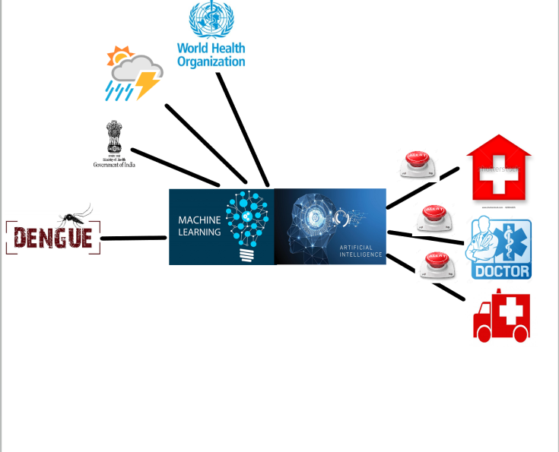
Disease Outbreak Prediction Model Architecture

Slide 5
Data points | Area, Month, Avg_Temperature_16, Avg_Temperature_17, Rainfall_16, Rainfall_17, Altitude, Avg_Humidity_16, Avg_Humidity_17, Dengue_cases_16 and Dengue-cases_17.
Machine learning classifiers | Linear Regression and Logistic Regression.
Tools & Data Points

Slide 6
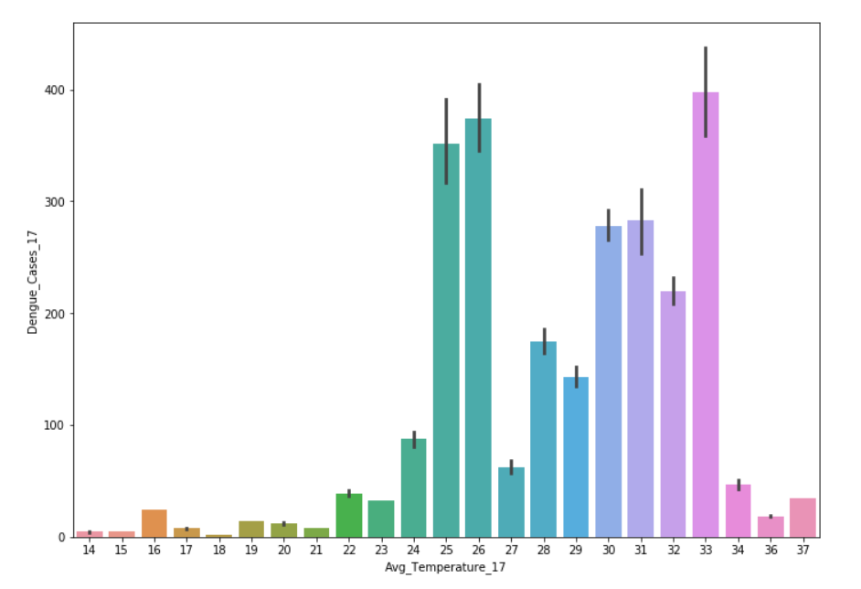
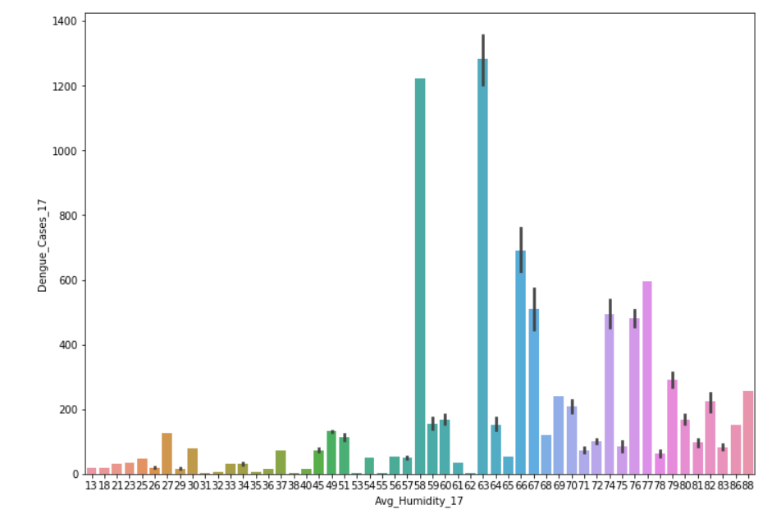
Results

Slide 7
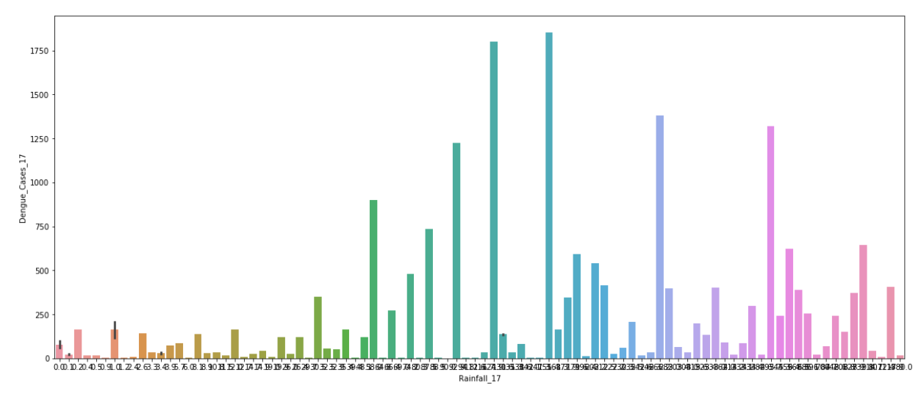
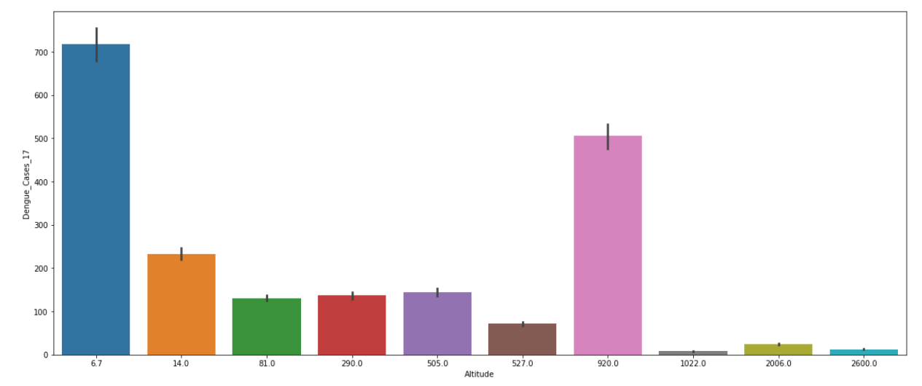

Slide 8
Conclusion
Based on our study and observations the geographical factors like temperature , humidity and rainfall play a huge role in determining the life cycle of the dengue carrying mosquito.
We can see that at low temperatures and at very high temperatures dengue cases are very less.
As humidity increases the chances of dengue spreading increases.
We can also see that as rainfall increases steadily mosquito breeding increases and also decreases at very high rainfall conditions.
As the altitude decreases the chances of dengue spreading is high.

Slide 9
Thank You

